Slide 1
Chapter 9 Relations
Notes:
9.2不要求
关系的比较麻表示 , 特殊的关系：对称等关系
闭包关系（传递闭包烦）
考的时候算起来麻烦（考传递）
等价关系：需要做证明
对应与一个划分
偏序关系要清楚（性质）
把哈赛图弄明白

Slide 2
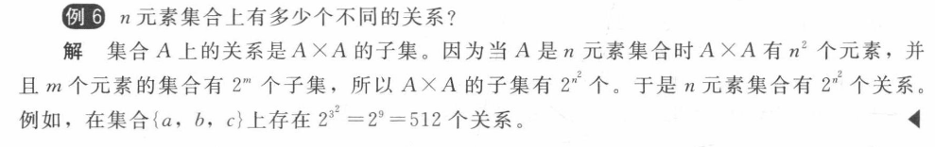
【Definition】A binary relation R from a set A to a set B is a subset of A×B.
Note:
A binary relation R is a set.
R ⊆ A×B

Slide 3
Question:
How many binary relations are there on a set A with n elements?
0,1
By the product rule,

Slide 4
【Definition】A relation R on a set A is reflexive 自反性 if
对角线应该全为1

Slide 5
【Definition】A relation R on a set A is irreflexive非自反 if
对角线全是0
可以既不是reflexive 也不是 irreflexive

Slide 6
【Definition】A relation R on a set A is symmetric对称 if
Questions:
The connection matrix of a symmetric relations?

Slide 7
【Definition】A relation R on a set A is antisymmetric反对称 if
即不存在任何一个对称对位于关系R中
reflexive, symmetric, antisymmetric, transitive
既对称又反对称
【Definition】A relation R on a set A is transitive传递的if whenever

Slide 8
〖Example 8〗How many relations are there on a set with n
elements that are
(1) reflexive ?
(2) symmetric ?
(3) antisymmetric ?
Solution:
(1)
0,1
(2)

Slide 9
Solution:
(3)

Slide 10
7. Combining Relations
就是普通的集合运算
Let , the set
operations of two relations are defined by

Slide 11
2) Composition
The composite of R and S:
就是关系的传递
关系矩阵乘法

Slide 12
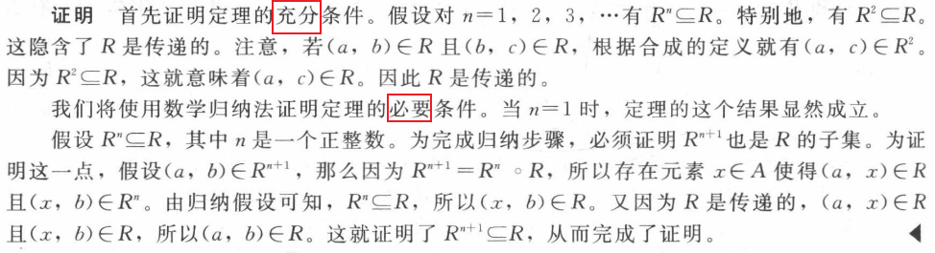
【 Theorem 】 The relation R on a set A is transitive if and
only if
一般都用数学归纳法，或者用关系矩阵的运算

Slide 13
3) Inverse relation
The inverse relation from B to A:
Question:
How to get ?
Using the definition directly
For example,
(2) Reverse all the arcs in the digraph representation of R
(3) Take the transpose M_{R} ^{T} of the connection matrix M_{R} of R.

Slide 14
9.4 Closures of Relations

Slide 15
9.4 Closures of Relations
1. Reflexive Closure
【 Theorem 】 R 是A上的关系. The reflexive closure自反闭包
of R, denoted by r(R), is
The diagonal relation on A
① containing R
② is a reflexive relation
③ is the smallest reflexive relation which contains R
Suppose that R' is a reflexive relation containing R, then
闭包就是最小的满足性质P的R的扩展
【 Corollary 】 ⇔ R is a reflexive relation .

Slide 16
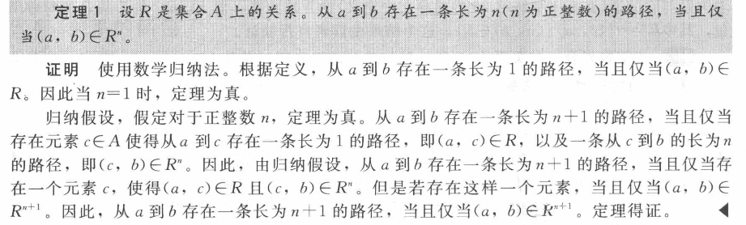
9.4 Closures of Relations
2. Symmetric Closure
【 Theorem 】 Let R be a relation on A. The symmetric closure
对称闭包 of R, denoted by s(R ), is
Notes:
路径是可以重复走的

Slide 17
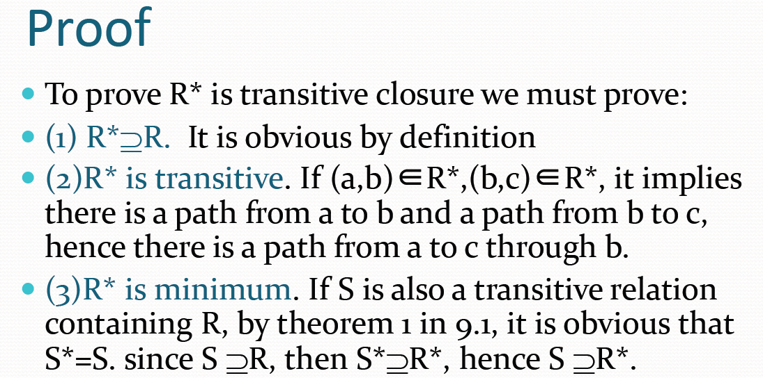
9.4 Closures of Relations
【 Theorem 】传递闭包 t(R) = R*.

Slide 18
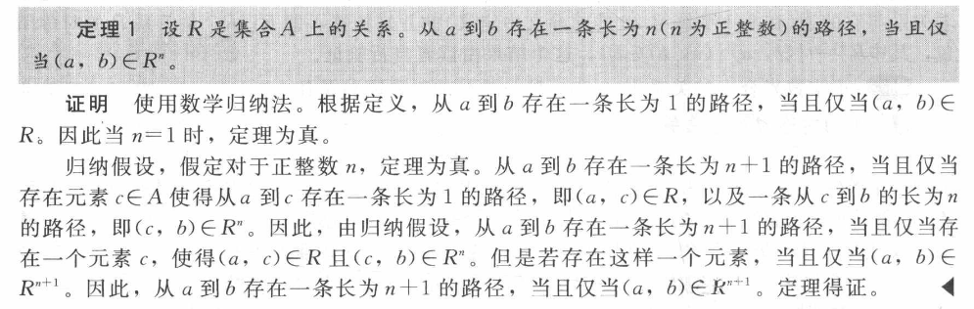
9.4 Closures of Relations
【Definition】 The connectivity relation连通性关系 denoted by R*

Slide 19
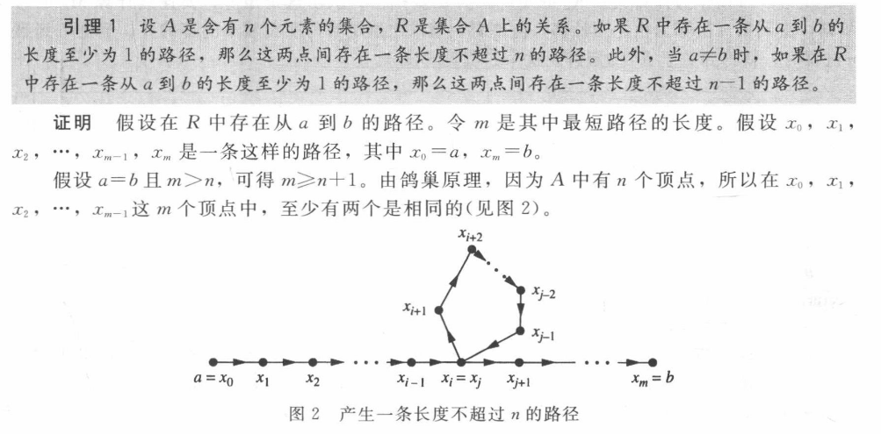
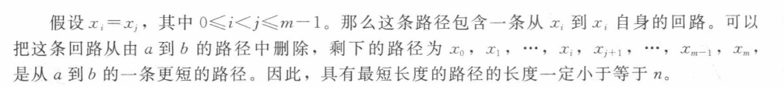
9.4 Closures of Relations
推得
【Corollary】 If , then

Slide 20
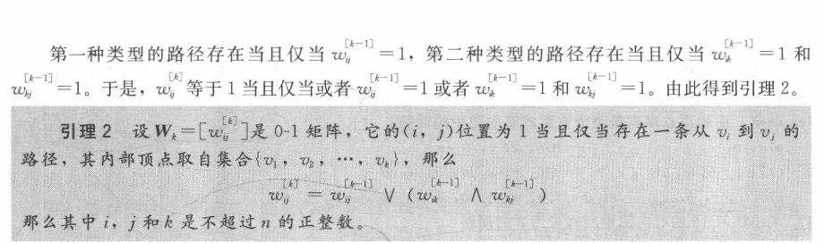
9.4 Closures of Relations
Warshall’s Algorithm 沃舍尔算法
Warshall 矩阵
传递闭包的关系矩阵
从Wk-1到Wk，Wk首先继承Wk-1的1，然后找传递，关键就是观察上式子

Slide 21
9.4 Closures of Relations
〖Example 3〗 Let
Solution:

Slide 22
9.5 Equivalence Relations
等价关系

Slide 23
1. Equivalence relations and equivalence classes
【Definition】A relation R on a set A is an equivalence relation if R is
Reflexive 自反
Symmetric 对称
transitive 传递
证明是等价类只需要证明上面这3条

Slide 24
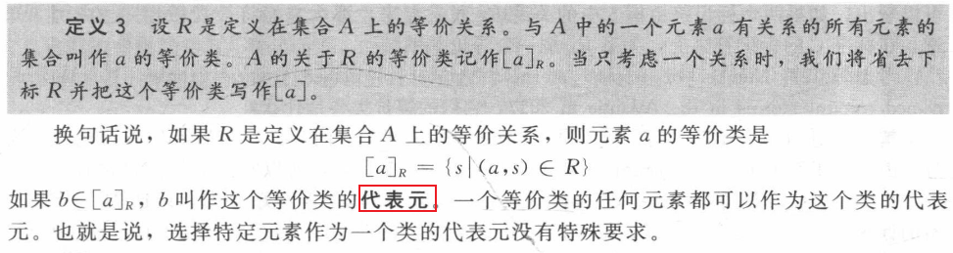
9.5 Equivalence Relations
Terminologies:
a and b are equivalent
R is an equivalence relation, and (a , b)∈ R
Notation: a ~ b
the equivalence class of x
The set of all elements that are related to an element x of A
Notation:

Slide 25
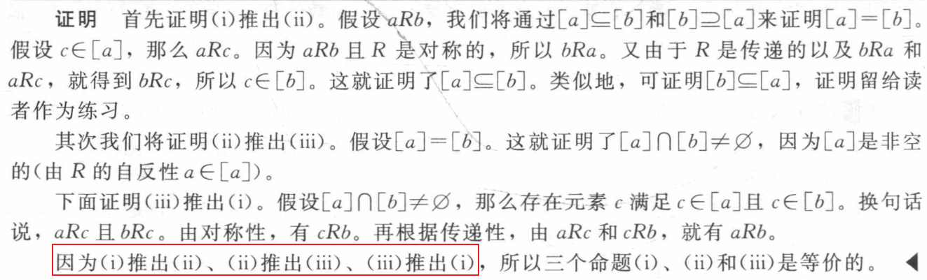
9.5 Equivalence Relations
【 Theorem 1】 R 是A上的等价类. 下列的表达式是等价的

Slide 26
9.5 Equivalence Relations
2. Equivalence relations and partitions
【Definition】A partition分割 of set A is a collection of disjoint nonempty subsets of A that have A as their union.
Let be a collection of subsets of A. Then the collection forms a partition of A if and only if
A₂
A₁
A₄
A₃
A₅

Slide 27
9.5 Equivalence Relations
【 Theorem 2】 Let R be an equivalence relation on a set A.
Then the equivalence classes of R form a partition of A.
Conversely, given a partition of the set A, there is
an equivalence relation R that has the sets ,
as its equivalence classes.
an equivalence relation on a set A ↔ a partition of A

Slide 28
9.5 Equivalence Relations
〖Example 3〗 Find the partition of the set A from R.
Solution:
4
[0]={0}
[1]={1,2,3}
[4]={4,5}
pr(A)={ [0], [1], [4]}
1
0
3
2
5

Slide 29
9.5 Equivalence Relations
Question:
Congruence Modulo m
Question:
|A|=3. How many different equivalence relations on the set A are there?
Solution:
an equivalence relation on a set A ↔ a partition of A

Slide 30
9.5 Equivalence Relations
3. The operations of equivalence relations
【 Theorem 3】 If are equivalence relations on A, then
is an equivalence relation on A.
Proof:
reflexive relations is reflexive,
symmetric relations is symmetric,
and
transitive relations is transitive.
Notes:
但是不传递

Slide 31
9.5 Equivalence Relations
【 Theorem 4】 If are equivalence relations on A, then
is a reflexive and symmetric relation on A.
Proof:
(1) reflexive
(2) symmetric
不transitive
Notes:
这部分书上也是没有的

Slide 32
9.6 Partial Orderings

Slide 33
9.6 Partial Orderings
1. Partial Orderings
【Definition】Let R be a relation on a set S. Then R is a partial ordering or partial order if R is
reflexive
antisymmetric 反对称的
transitive
Notation: (S, R) ---- poset偏序集
Notation:
a ≼ b

Slide 34
9.6 Partial Orderings
linearly ordered set全序或者线序集， chain链
〖Example 2〗
(1) is a poset. In this case either . Hence, ≤ is a total order and is a chain.
(2) is a poset, not a totally ordered set.
(3) is a poset, not a totally ordered set.

Slide 35
9.6 Partial Orderings
2. well-ordered 良序
一般来说偏序如果要比大小就是字典序Lexicographic Order

Slide 36
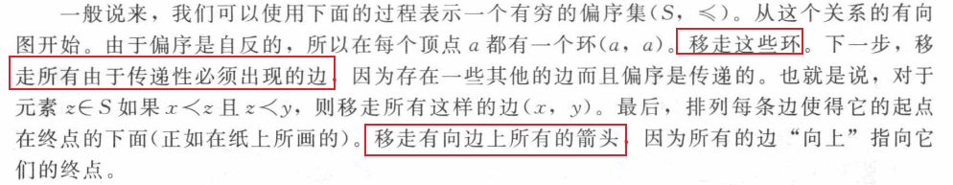
9.6 Partial Orderings
3. Hasse Diagrams
Hasse Diagrams
---- A method used to represent a partial ordering
更快的方法
先把没有出现在以下所有关系的值域（<a,b>, 其中b为值域）的元素放在第一排。如有多个，一起放在第一排。然后可比的属性之间连线

Slide 37
上界：所有 大于等于
上确界： 上界最小 唯一（有两个就是没有）
极大：就是在子集中它的上面没有元素
最大值：子集中处于最高层且每个元素通过图中路径都可以找到它且它的上面没有元素（最大值从极大值里面找） 唯一（有两个就是没有）
maximal element极大元
greatest element 最大元
least upper bound,lub(A).
greatest lower bound, glb(A).

Slide 38
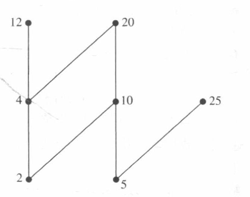
9.6 Partial Orderings
对于全集，12，15，20都是极大值

Slide 39
9.6 Partial Orderings
〖Example 8〗
Determine the maximal elements, minimal elements, greatest
element, least element of set A, the upper bounds, lower bounds ,
least upper bound , greatest lower bound of set 。
A:
maximal elements: 24,36 minimal elements:2,3
the greatest element: / the least element: /
24
36
12
B₁:
upper bounds: 6,12,24,36 lower bounds: /
The least upper bound: 6 The greatest lower bound:/
6
2
3
B₂:
upper bounds: / lower bounds: 12,6,2,3
The least upper bound: / The greatest lower bound:12

Slide 40
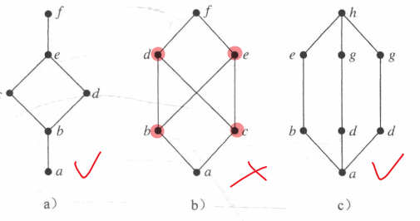
9.6 Partial Orderings
10. Lattices 格
【Definition】偏序集中的每对元素都有最小上界和最大下界

Slide 41
9.6 Partial Orderings
(2) ?
lub：the larger of the two elements，
glb：the smaller of the two elements.
Hence, the poset is a lattice.
Note: Every totally ordered set is a lattice.
(3) ?
lub：the least common multiple，
glb：the greatest common divisor
Hence, the poset is a lattice.
(4) ?
, lub： glb：
Hence, the poset is a lattice.

Slide 42
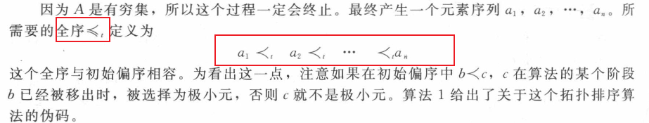
9.6 Partial Orderings
11. Topological Sorting 拓扑排序
只要 就有 ，则称一个全序≤和偏序R是相容compatible)
从一个偏序构造一个相容的全序称为topological sorting拓扑排序
拓扑排序可能不唯一，有穷非空的偏序一定有拓扑排序

Slide 43
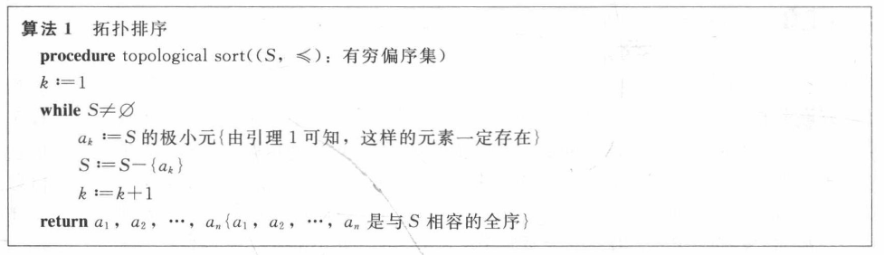
9.6 Partial Orderings
每次选一个极小元

Slide 44
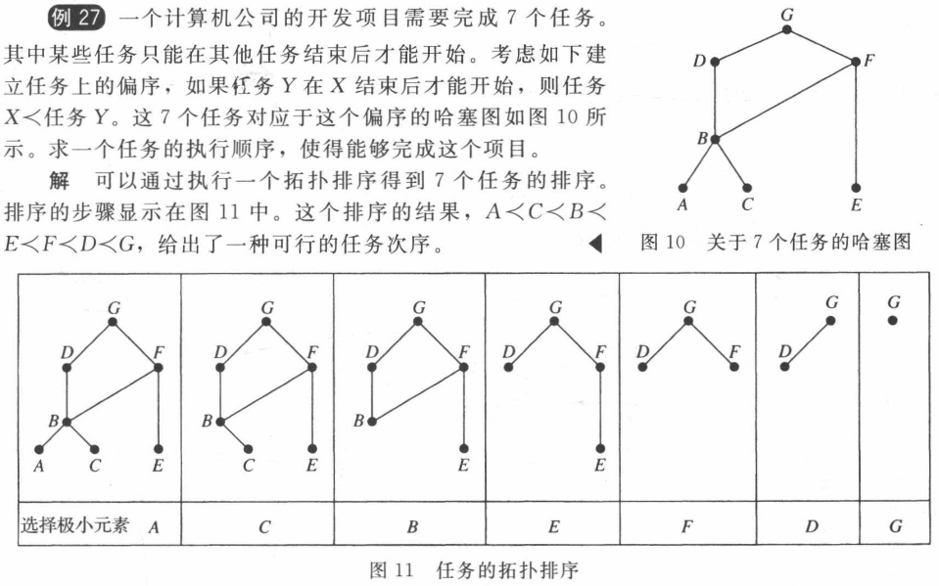
9.6 Partial Orderings

